Slide 1
CUSTOMER APPRECIATION
Suzanne Drake Carle, ProLaureate
© 2011

Slide 2
“grategy” for financial planners

Slide 3
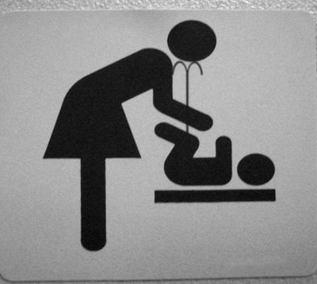
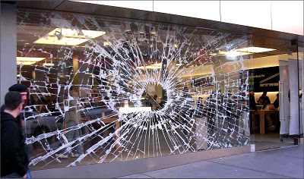
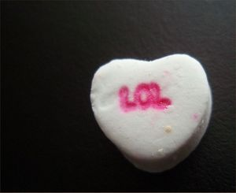
…for sign makers
YOUR HOUSE
Speechless
Come on in!
Dates

Slide 4
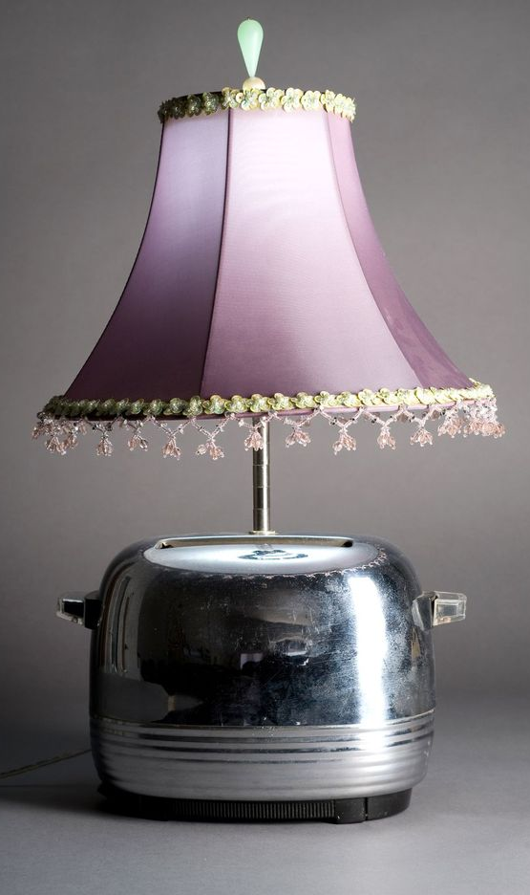
…for real estate agents

Slide 5
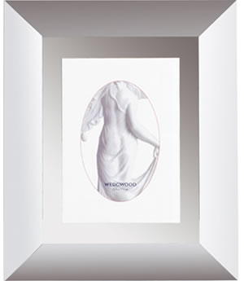
…for art gallery partners
“It’s been a great year at Bonfoey.
Thank you for being such a big part of it.”
Framed prints, magnets, window stickers….

Slide 6
…for college representatives

Slide 7
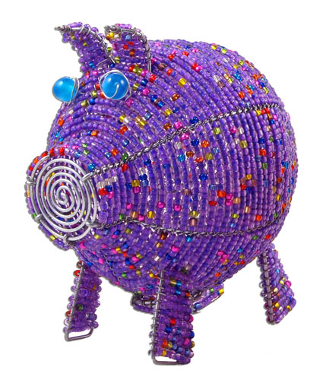
…for artists

Slide 8
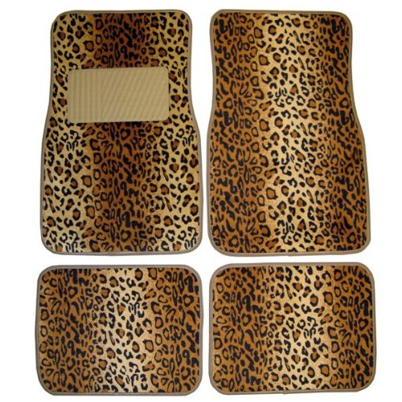
…for auto dealers & car care specialists

Slide 9
…for heating/cooling owners

Slide 10
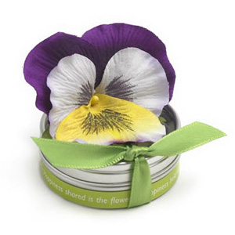
…for landscapers

Slide 11
…for fundraisers

Slide 12
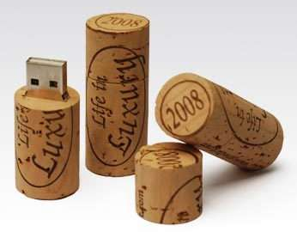
…for professional writers

Slide 13
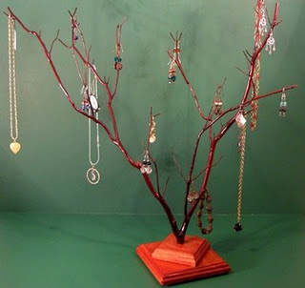
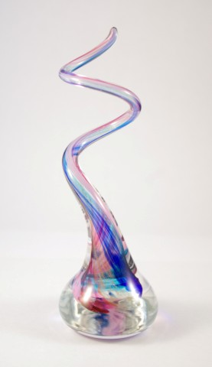
…for jewelers

Slide 14
….for title company professionals

Slide 15
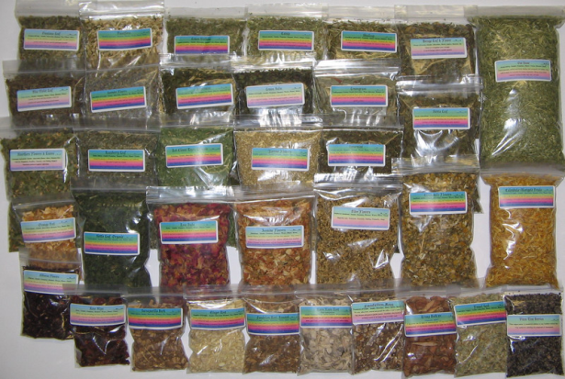
…alternative health care professionals

Slide 16
…for coffee providers

Slide 17
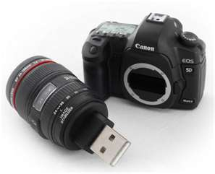
…for it attorneys

Slide 18
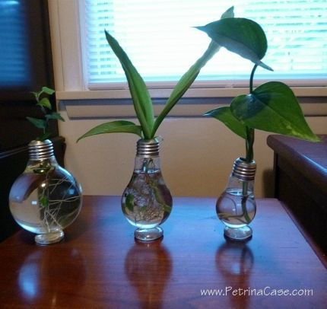
…for promoters of green living

Slide 19
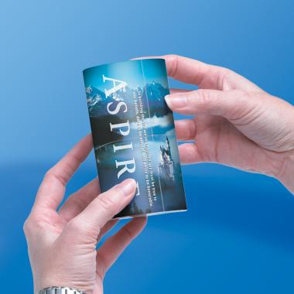
…for staffing specialists

Slide 20
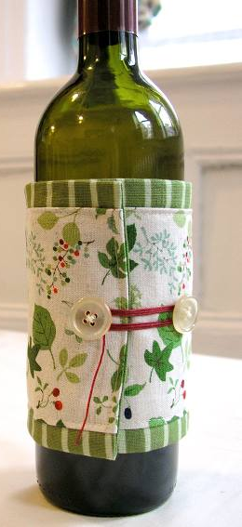
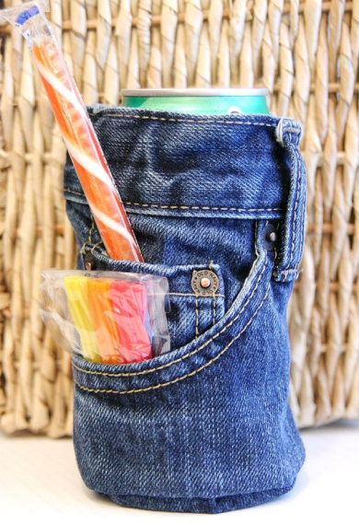
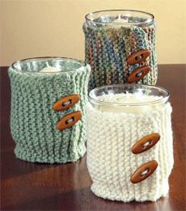
…for member services managers
CO E
S
S

Slide 21
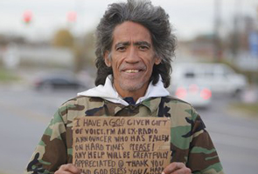
….for marketing professionals
…see all other slides.
Katrina
Haiti
Cleveland
Japan

Slide 22
…for “grategy” specialists
marlene
Celadon Road
give
thoughtful detail:
shirt is 100% cotton & made in the USA.

Slide 23
Need more help? suzanne drake carle 216.233.9807 suzcarle@prolaureate.com
have fun & be creative!

